Slide 1


AUTOMOTIVE LOANS
DEFAULT FORECAST
WITH ML CLASSIFIERS

Slide 2
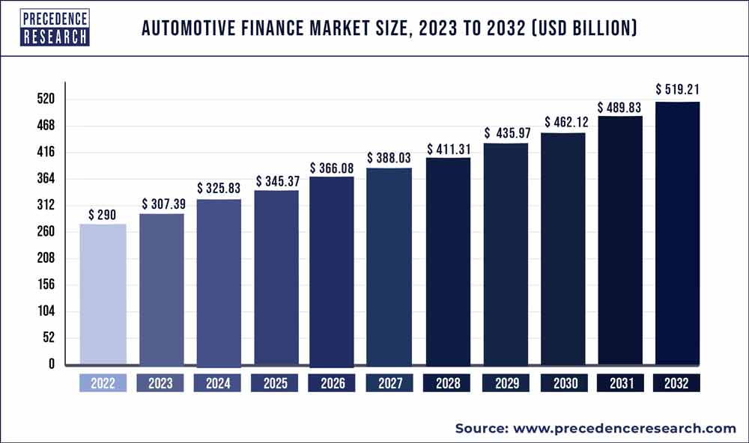
Financial institutions demand accurate credit risk models to identify factors causing vehicle loan defaults.
92% of new cars and a growing number of used cars purchased using finance agreements
80% of the financing are loans without collateral
Developing countries present promising target markets as demand saturates in developed nations, but the risks are higher.

Slide 3

DATA
The original dataset contains 233,155 train and 112,393 test observations, 40features, and a target vector 'loan_default’.
has one float64 type, five objects,
and the rest are int64.
Despite the datatype, 15 represent categories that require corresponding treatment before processing.

Slide 4
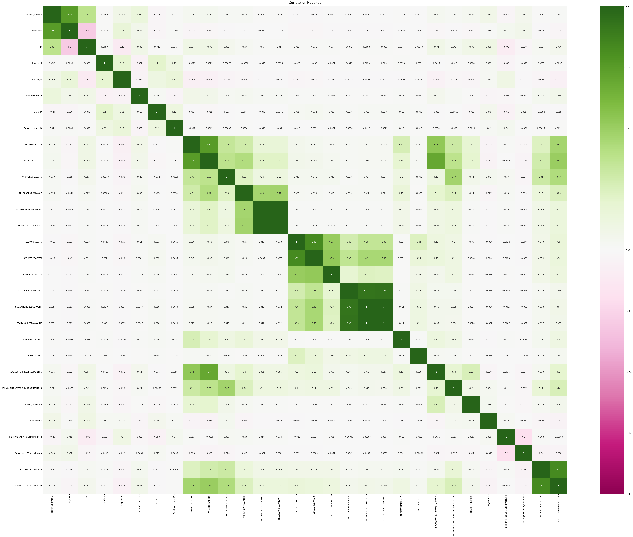
Categorical data pre-processing was the most time , code and methods consuming
double and missing values
date-time transformations
One Label Encoding and One-hot encoding for ID objects
Ordinary variables encoding
Standard Scaler

Slide 5
Features engineering methods prior training
Elimination of linearly dependent columns to maintain the model parsimonious and avoid colinearity
Outliers of the numerical Data
Mutual information test for categorical data
This technique quantifies the association between two variables through mutual information, where higher values suggest a stronger dependency. It employs nonparametric approaches and estimates entropy based on k-nearest neighbors distances. However, the analysis did not yield significant values for these attributes.
Mutual information for a discrete target variable.
Mutual information (MI) [1] between two random variables is a non-negative value, which measures the dependency between the variables. It is equal to zero if and only if two random variables are independent, and higher values mean higher dependency.

Slide 6
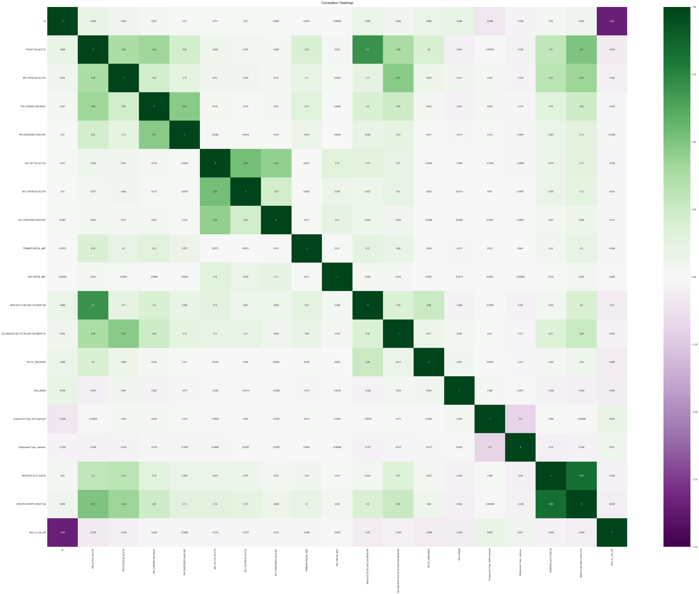
As result 14 features were removed from the model:
6 IDs
5 with correlation coefficient higher than 83%
4 features with 2% non zero values combined to high spread beyond IQR in the data frame as noise

Slide 7
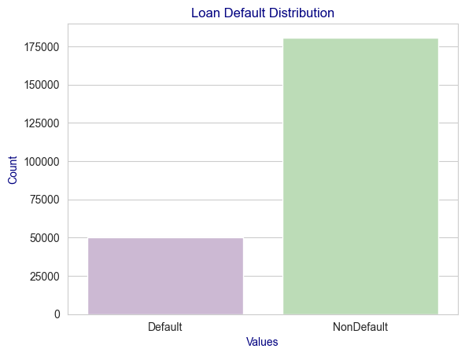
Balancing uneven target variable distribution in the sample with SMOTE method variation for mixed data
The Synthetic Minority Over-sampling Technique (SMOTE) is a method used to balance imbalanced datasets by randomly generating synthetic samples of the minority class.
SMOTE works by selecting instances from the minority class, then creating new instances by interpolating between them and their k-nearest neighbours.
This approach improves the performance of machine learning models by addressing the issue of class imbalance in the training data.

Slide 8
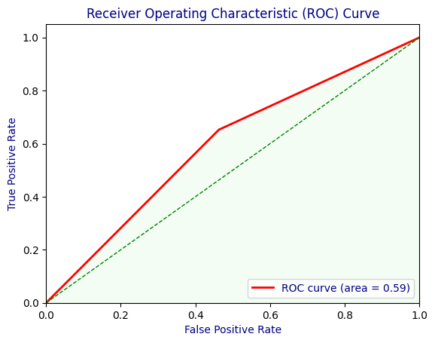
Logistic regression for binary classification, ROC-AUC:
Linear regression classifier: "Logistic Regression (also called Logit Regression) is commonly used to estimate the probability that an instance belongs to a particular class.
If the estimated probability is greater than 50%, then the model predicts that the instance belongs to that class (called the positive class, labeled '1'), or else it predicts that it does not (i.e., it belongs to the negative class, labeled '0’).
the algorithm's AUC score is equivalent to Avidya contestants
Accuracy of logistic regression model 0.5953338251567687
F1 Score 0.6171456490254585
Recall Score 0.6541392320781239
AUC score: 0.5954982189964665

Slide 9
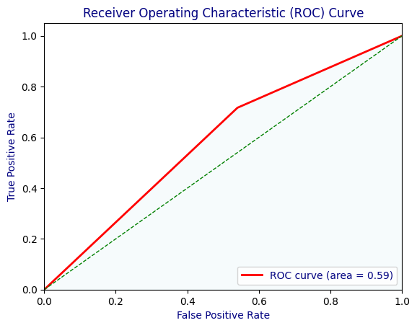
SVM for binary classification, defining the decision boundary, ROC-AUC:
A Support Vector Machine (SVM) is a powerful and versatile Machine Learning model, capable of performing linear or nonlinear classification
Add Import: Intel® Extension for Scikit-learn to accelerate the computing speed: 221K&21 matrix takes 50-70 minutes, depending on the kernel.
Accuracy of the Support Vector Machine: 0.5879380302471413
F1 Score: 0.6343251824936986
Recall Score: 0.7168010653251461
AUC score for SVM: 0.5882982741471607

Slide 10
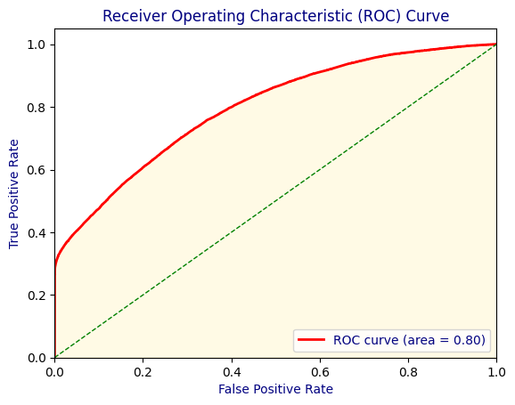
XGBoost is the absolute champion for the binary classification task, ROC-AUC:
An ensemble algorithm, based on Random Forests and Gradient Descend methods
Allows parallel processing - particularly efficient with multicore processors
Outliers tackling within the method combined with powerful Feature selection are based on Random Forests trees branches probability scores assignments.
Accuracy of XG: 0.7075986720767244
F1 Score: 0.7097187637322396
Recall Score: 0.7169120366945329
AUC score for xgBoo: 0.7971739089887604

Slide 11
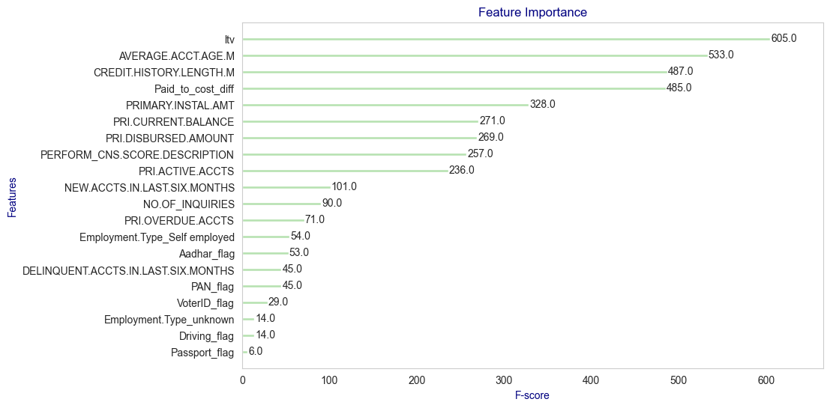
The Feature Selection insights: The loan-to-value ratio, average account age, and lending history length are the most significant features.

Slide 12

Conclusion: Despite the success of the GXBoost model, there is potential for further improvement.
AUC-ROC graphs indicated that a linear model might not be the best fit for this dataset, suggesting the need to explore more flexible models.
Incorporating ID features as factors and applying logarithmic transformations to numeric features before standardization could enhance the model's performance.
Additionally, using cloud services such as AWS can help overcome hardware limitations and enable the use of Grid Search for hyperparameter tuning with SVM.
Future work could also involve applying additional powerful combination of algorithms, such as Random Forest and Neural Networks.

